Slide 1
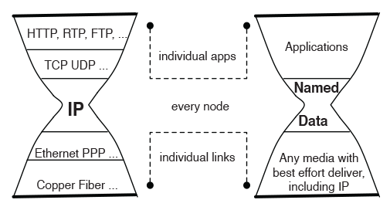
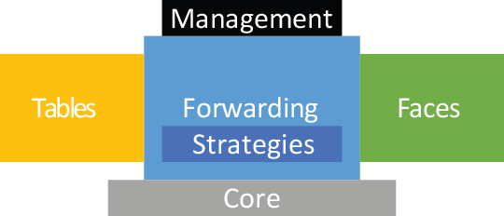
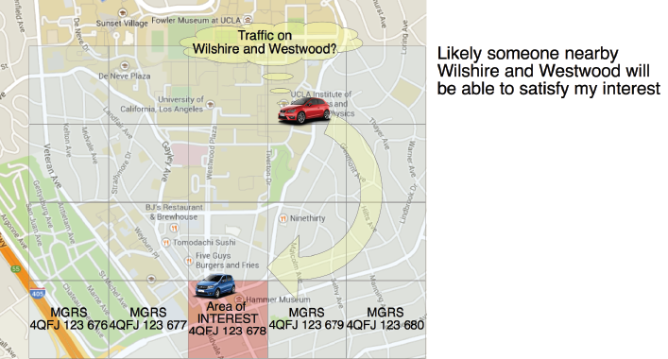
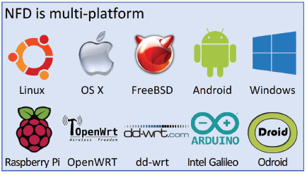
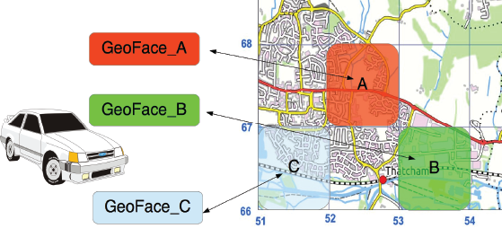
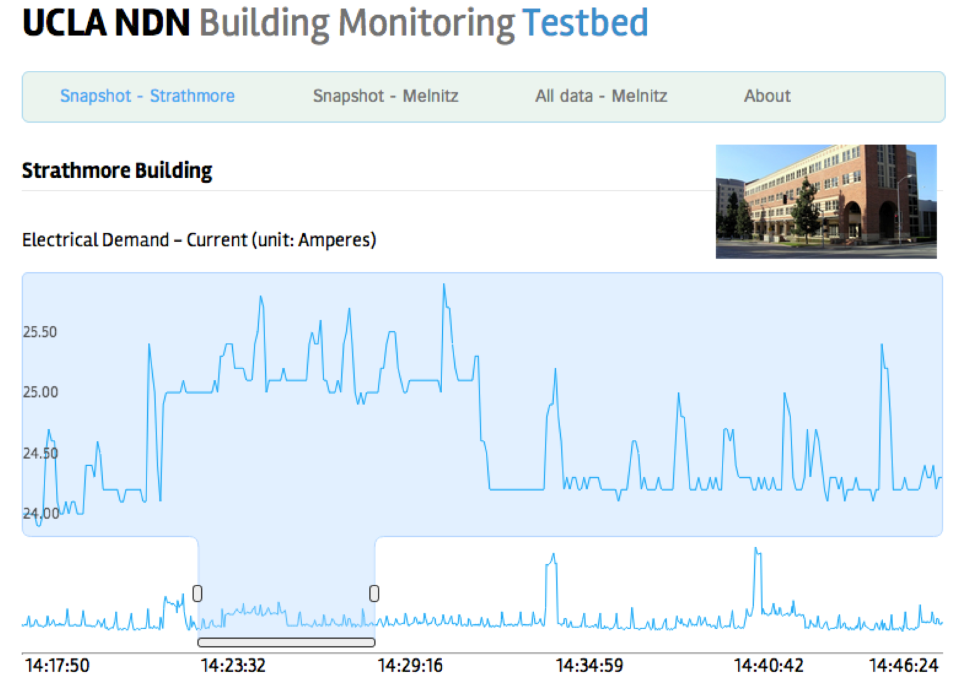
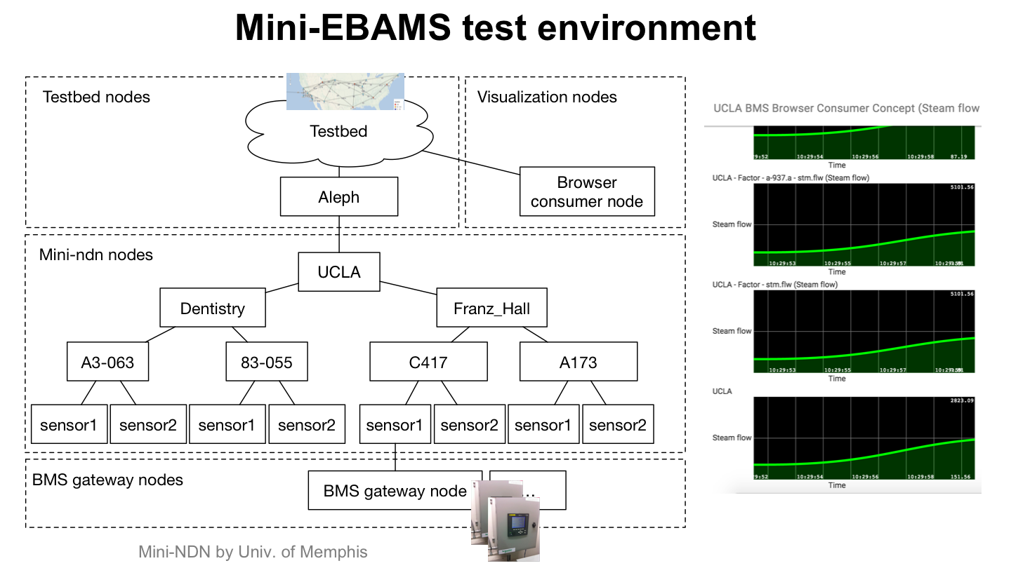
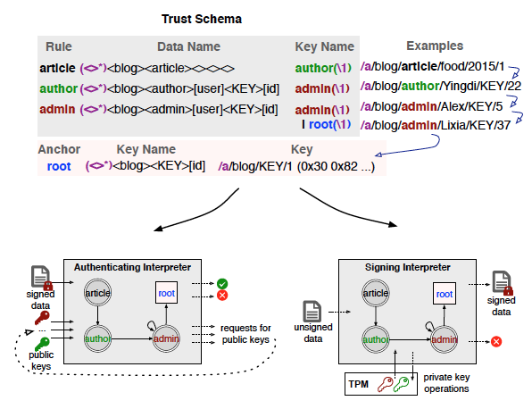
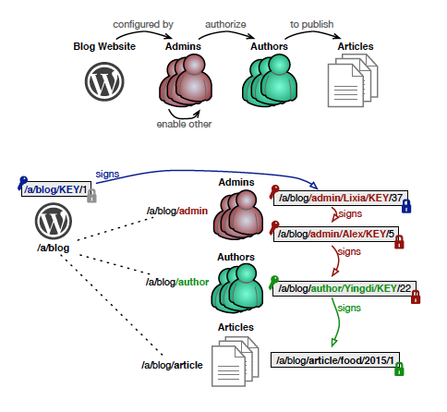
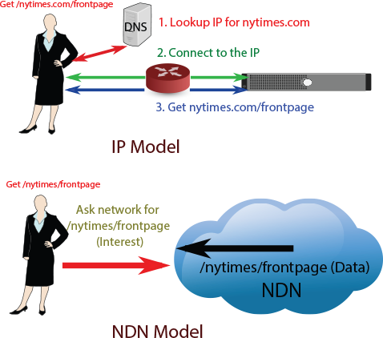
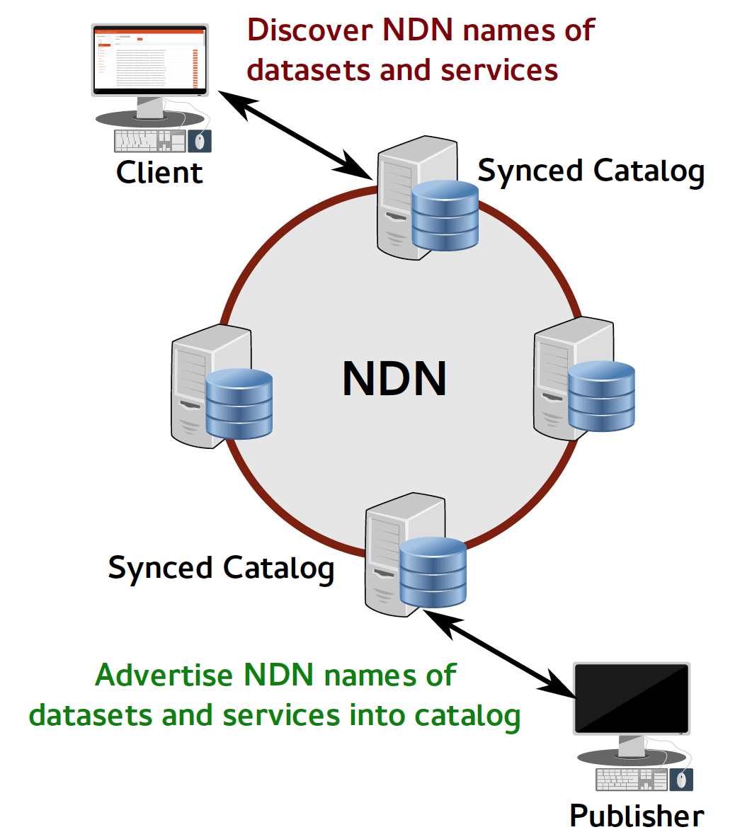
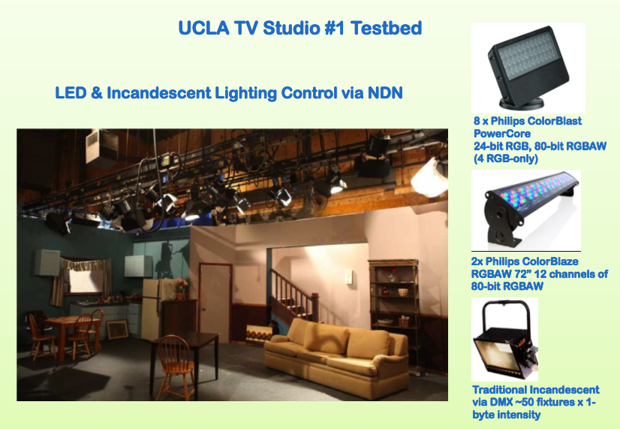
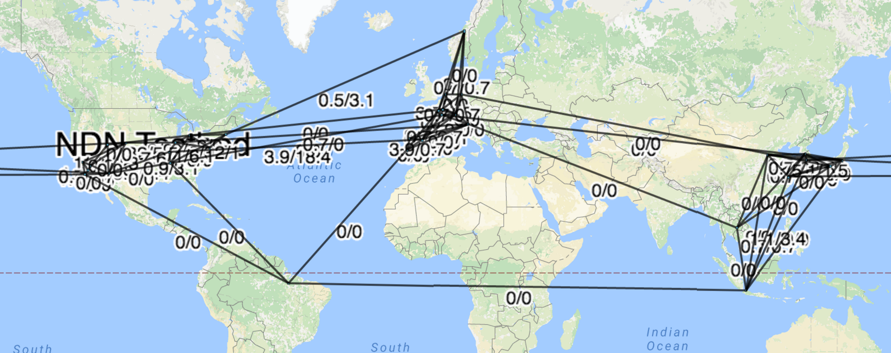
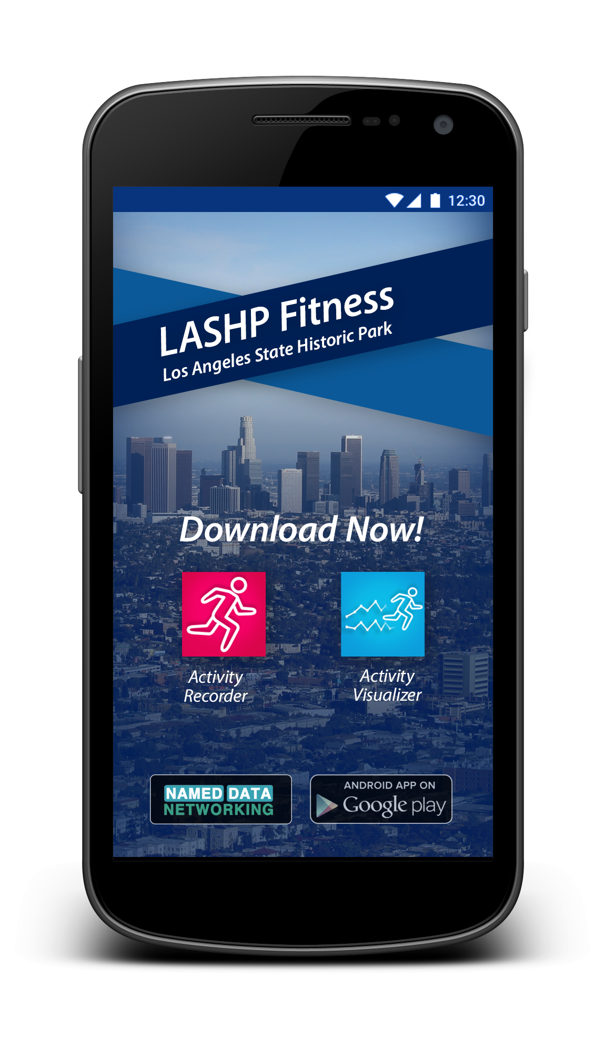
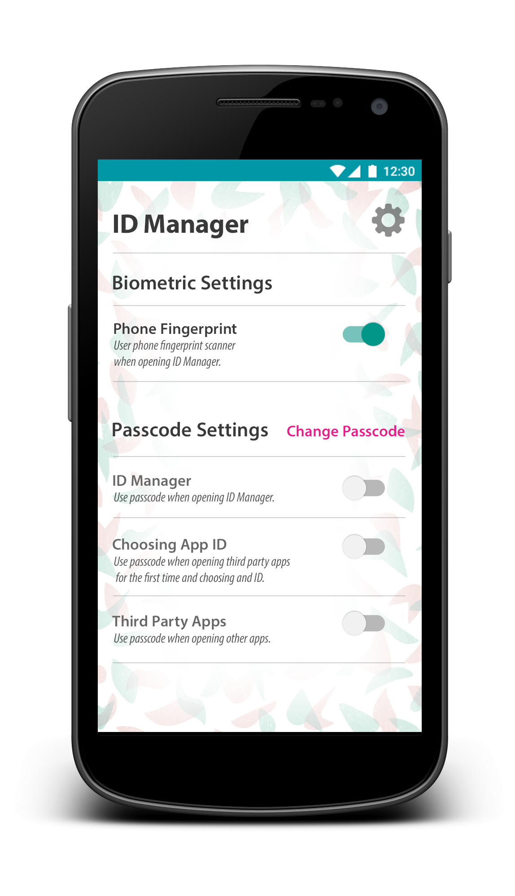
Named Data Networking
*Authors’ names go here*
Your subtitle or group name can go here
Interest Forwarding by Geolocation in Vehicular Named Data Networking
Architecture
NDN Forwarding Daemon
The natural binding between data and geographic areas can be exploited to guide the interest forwarding process in a V2V network. The NDN daemon can forward the corresponding Interest towards that
specific area.
A consumer can guess where location-based Interests could be satisfied and can use GeoFaces to share this information with the forwarder.
We divide the world into regions according to the Military Grid Reference System (MGRS)
Each area is associated with a particular face, so called GeoFace
All packets going toward a specific area A or coming from A (on the V2V network) are sent/received using GeoFace_A
The consumer binds the name of the content located in such areas to its corresponding GeoFace using the standard FIB prefix registration
NFD is a network forwarder that implements and evolves together with the NDN protocol. NFD has:
named‐based forwarding table
in‐network caching, with multiple cache replacement policies
measurement table to support forwarding intelligence
stateful and adaptive forwarding plane
built‐in loop freedom
built‐in data multicast
per‐namespace strategy choice
network Nack for fast failure recovery
Link object for mobility support
The NDN project aims to develop a new Internet architecture that can capitalize on strengths — and address weaknesses — of the Internet’s current host-based, point-to-point communication architecture in order to naturally accommodate emerging patterns of communication. The NDN project was funded by NSF in September 2010as one of the four projects under NSF’s Future Internet Architecture Program.
https://named-data.net/
NFD Codebase
• Language: C++11
• Build system: waf
• Boost libraries
• Unit testing required
• Doxygen + Sphinx documentation
• Redmine issue tracker
• Gerrit code review
• Jenkins + Travis continuous integration
Experiment with NFD on
• ndnSIM
• Mini‐NDN
• Vagrant
• Open Network Laboratory
• Emulab
Enterprise Building Automation and Management Systems
Trust Schema
Large Scale Data Management
Application
Simpler, secure alternative to middleware and cross-layer stacks in industrial control / SCADA.
NDN Benefit
Express physical relationships of buildings and subsystems naturally in names.
Avoid brittleness of middleware with host-based communication underneath.
Secure data and actuation directly based on names that embody trust relationships
Implementation Status
Second-generation prototype bridging live UCLA campus data to NDN testbed with hierarchical aggregation and trust model. Mini-NDN emulation of building-wide deployment.
Describe the trust model in terms of relationship between data name and signing key name
using NDN name pattern, a regex-style expression
explicitly regulate authentication path
easy to customize
Automate data signing/verification
trust schema interpreter
create/sign keys/data according to trust schema
retrieve necessary certificate for authentication
Secure design pattern
security experts can define a few common trust
application developers select an appropriate one
Motivation:
Scientific data is large and problematic to manage
Data is often distributed across multiple sites
Data provenance is important but not built into data
Using NDN:
Existing data names are translated into NDN names
Publisher advertises NDN names to a catalog
The system maintains a federation of globally synchronized catalogs
Clients can query any catalog instance using Web UI
Asking the network for discovered NDN names retrieves data
NDN-RTC
NDN Testbed
Open mHealth
Application
Real-time audio/video/text chat library which allows many-to-many conferencing over the NDN network and requires no direct communication between peers
NDN Benefit
Intrinsic multicast and name-based forwarding enable, for example, consumer scalability and publisher failover.
Names support efficient random access to video slice, tier, and frame suitable for AR/VR and mobile media.
Implementation Status
Real-time conferencing app over NDN testbed with trust verification, 2nd generation for our team use in ‘16-17.
Name-based interface for media control and real-time video signal processing used in experimental production.
Application
User-centric health data exchange inspired by Estrin & Sim Open mHealth project.
NDN Benefit
User at root of trust model for their own health data.
Simplification of minimum requirements for interoperability.
Likely better at building distributed processing flows that cross administrative entities.
Implementation Status
End to end system with data capture, storage, processing, and visualization using NDN
Prototype end-user interfaces for identity management (now), and name-based access control (soon).
The NDN research testbed is a shared resource created for research purposes, that include software routers at several participating institutions, application host nodes, and other devices.
These instantaneous bandwidth measurement are collected using NDN Interest/Data
http://ndnmap.arl.wustl.edu/

